Slide 1

Welcome to Year 4
Class of ’26

Slide 2

I'd like to talk to you about...
A day in the life of Year 4
Topic coverage over the year
Visits
Home learning
How you can help your child

Slide 3
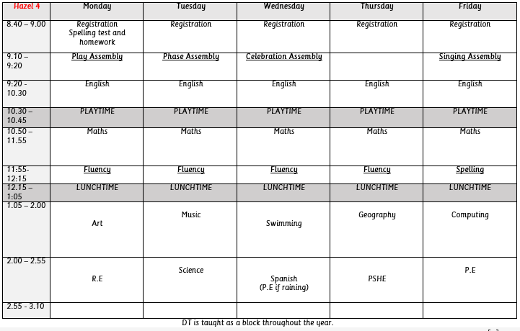
A Typical Year 4 Week
Notes:
Mel/Zoe, point out slight changes to timetable.

Slide 4
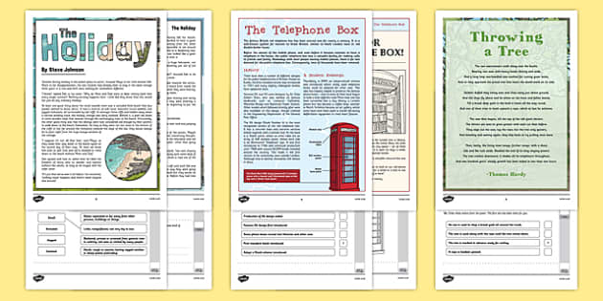

Increasing Reading Fluency

Slide 5

Maths
1. 2.Flashback 4
3. mental starter (inc. Times tables, recall of facts)
4. Main teaching
5. Independent work
6. Plenary
Your child will complete the Year 4 Multiplication Times Table Check June 2026.

Slide 6
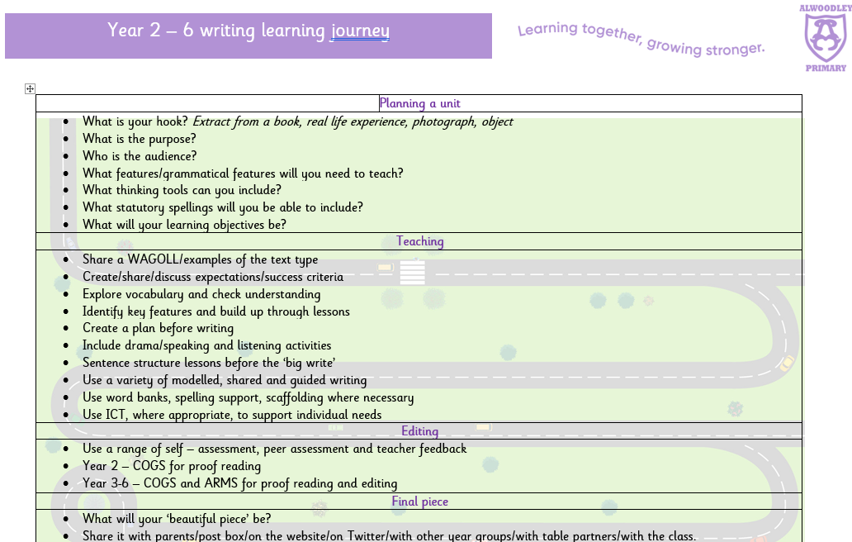
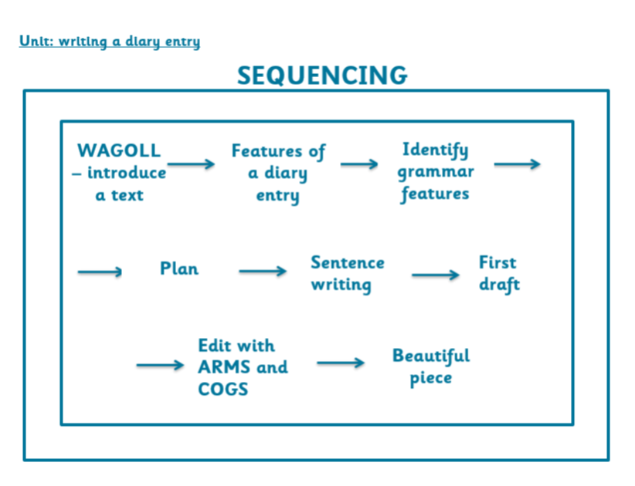

English

Slide 7
These are some of the topics covered throughout Year 4:
history- Ancient Egyptians, ancient Greece & Roman Britain
Geography – mountains and trade
D.T. – Sewing!
Art- Me, Myself and I (Links to our Golden thread of Personal development and PSHE)

Slide 8

Visits
Swimming- PE
Leeds city centre - geography
Murton Park - history
Mosque & church -re
Woods - pshe
Theatre – pshe
Big cAMP!

Slide 9
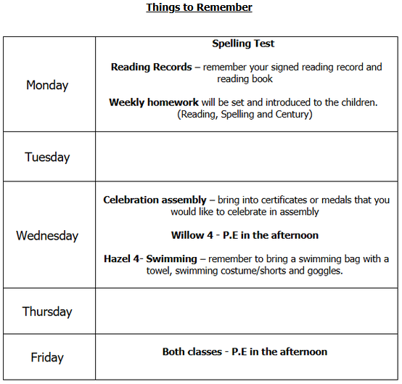
REMINDER: Please can your child bring in a pair of wellies for this school year.

Slide 10
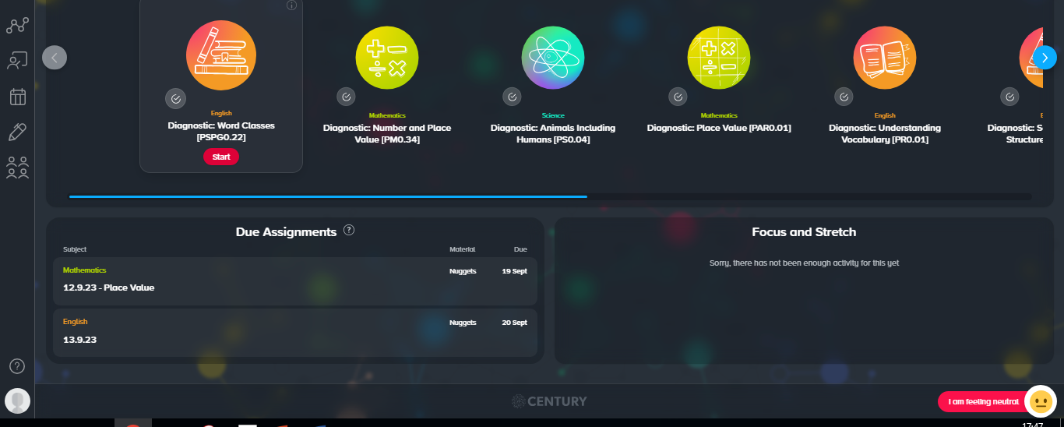
Home learning - Century

Slide 11
How to support your child in year 4
Reading aloud to an adult regularly, discussing vocabulary and asking questions.
Support children with their timetables.
Liaise with school. We are happy to support!

Slide 12

Any questions?

