Slide 1

Reading for Pleasure
Reading Rivers

Slide 2
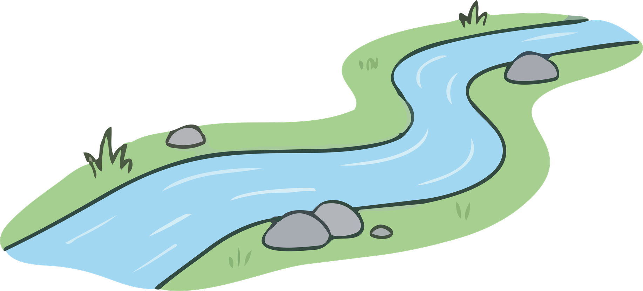
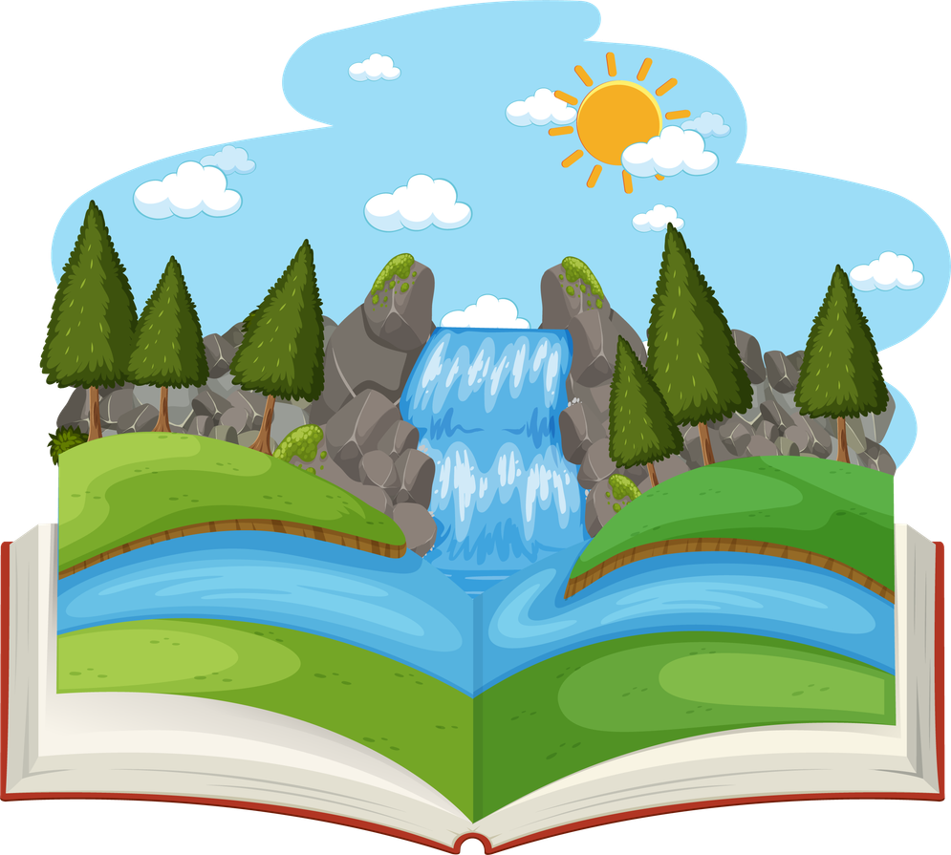
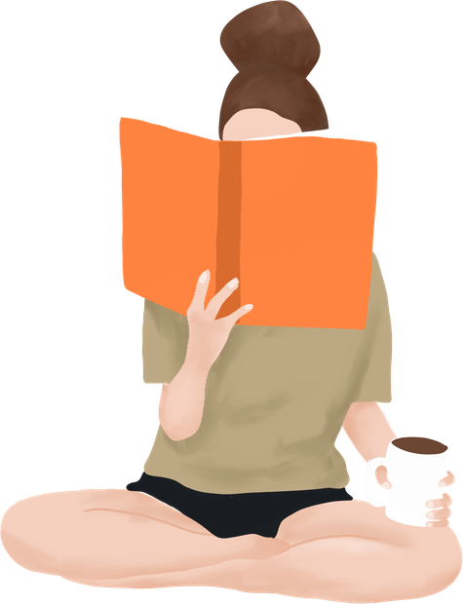
What is a Reading River?
A Reading River is a visual map of your reading journey.
It shows the books you have read, enjoyed and influenced you.
It’s your own personal Reading River so there are no right or wrong answers.
Reading Rivers

Slide 3
Think about everything you read, not just books. What stories, texts, authors and reading experiences have helped you become the reader you are today!
Which are your 3 favourite books?
What do you read digitally (websites, E-books, Game guides, Online articles?)
What do you read at home (instructions, recipes, food labels, magazines?)
Song lyrics, playscripts, poems, picture books?
One book you would recommend to a friend?
Do you have a surprising read?
One reading goal for Year 4?

Slide 4

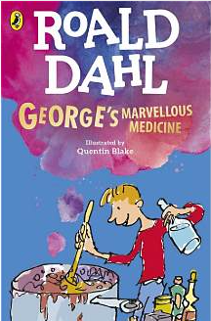
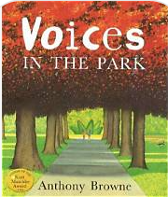
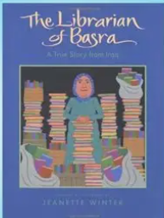
Create your own Reading
River
  Add books along the river in the order you discovered them.
  You can draw pictures, cut out book covers, add titles.

